Slide 1
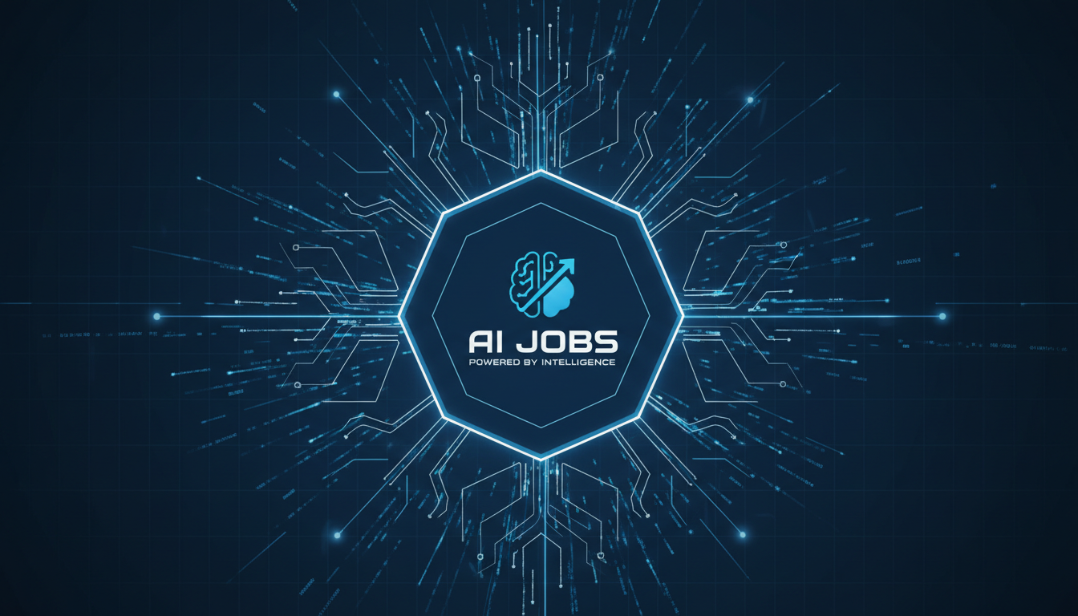
WILP DIVISION
JobSphere
AI-Powered Job Application Tracking Platform
BIRLA INSTITUTE OF TECHNOLOGY & SCIENCE, PILANI
Billa Ranga Sudarshan
(202117B3870)
Mentor: Ravi Shakar

Slide 2
Project Overview
Problem Statement
Tech Stack
Job seekers struggle to manage multiple applications across different platforms, leading to missed opportunities and disorganized job search workflows.
Python FastAPI backend, SQLite database, Vanilla JavaScript frontend - lightweight, efficient, and scalable architecture.
Impact
Solution
Streamlines entire job search workflow from discovery to offer acceptance, significantly improving efficiency and success rates.
Comprehensive web application that centralizes job search, application tracking, and interview preparation in one unified platform.
4+
99.9%
90.5%
Key Innovation
AI Models
Uptime
Test Coverage
AI-powered features using multi-model approach (Gemini, OpenAI, Groq, xAI) for intelligent job matching and resume optimization.

Slide 3
Key Features
Comprehensive suite of tools for modern job seekers
Job Search Integration
Application Tracking
AI Resume Builder
Interview Preparation
Multi-source job discovery from JSearch API, Adzuna, The Muse, and Remotive
Kanban board and traditional list view with comprehensive status management
Intelligent resume generation with ATS optimization and multiple templates
AI-powered mock interviews with personalized feedback and practice modes
Cover Letter Generator
Job Matching
Analytics Dashboard
Admin Panel
Automated, job-specific cover letter creation with professional tone
AI-based job recommendations aligned with user profile and career goals
Visual insights on application progress, success rates, and trends
Complete system management and user administration capabilities
All features are 100% free - No credit card required, no hidden fees
AI-Powered
Free Forever

Slide 4
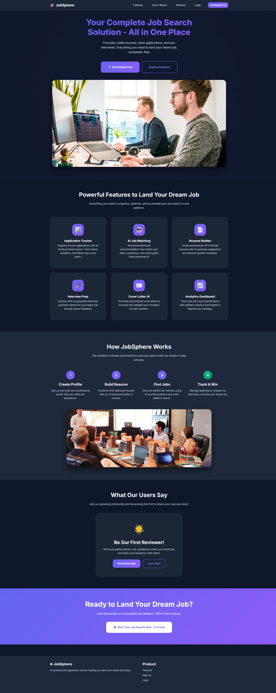
1
Landing Page
First impression and entry point to the platform

Slide 5
1
Landing Page - Process & Features
Creating a compelling first user experience
First Point of Contact
Professional Gradient Design
Clean, modern UI design that immediately communicates professionalism and technological sophistication
Visually appealing gradient backgrounds and modern color schemes creating a premium feel
Hero Section Highlights
Responsive Layout
Prominently displays core value propositions: AI-Powered functionality, 100% Free access, No Credit Card required
Ensuring compatibility across all devices - desktop, tablet, and mobile with fluid design
Call-to-Action Buttons
Professional Tone Setting
Strategically placed CTAs for immediate signup and login access, reducing friction in user onboarding
Establishes credibility and trust, setting the stage for the entire application experience
Design Philosophy: The landing page serves as the digital storefront, making a strong first impression that converts visitors into registered users

Slide 6
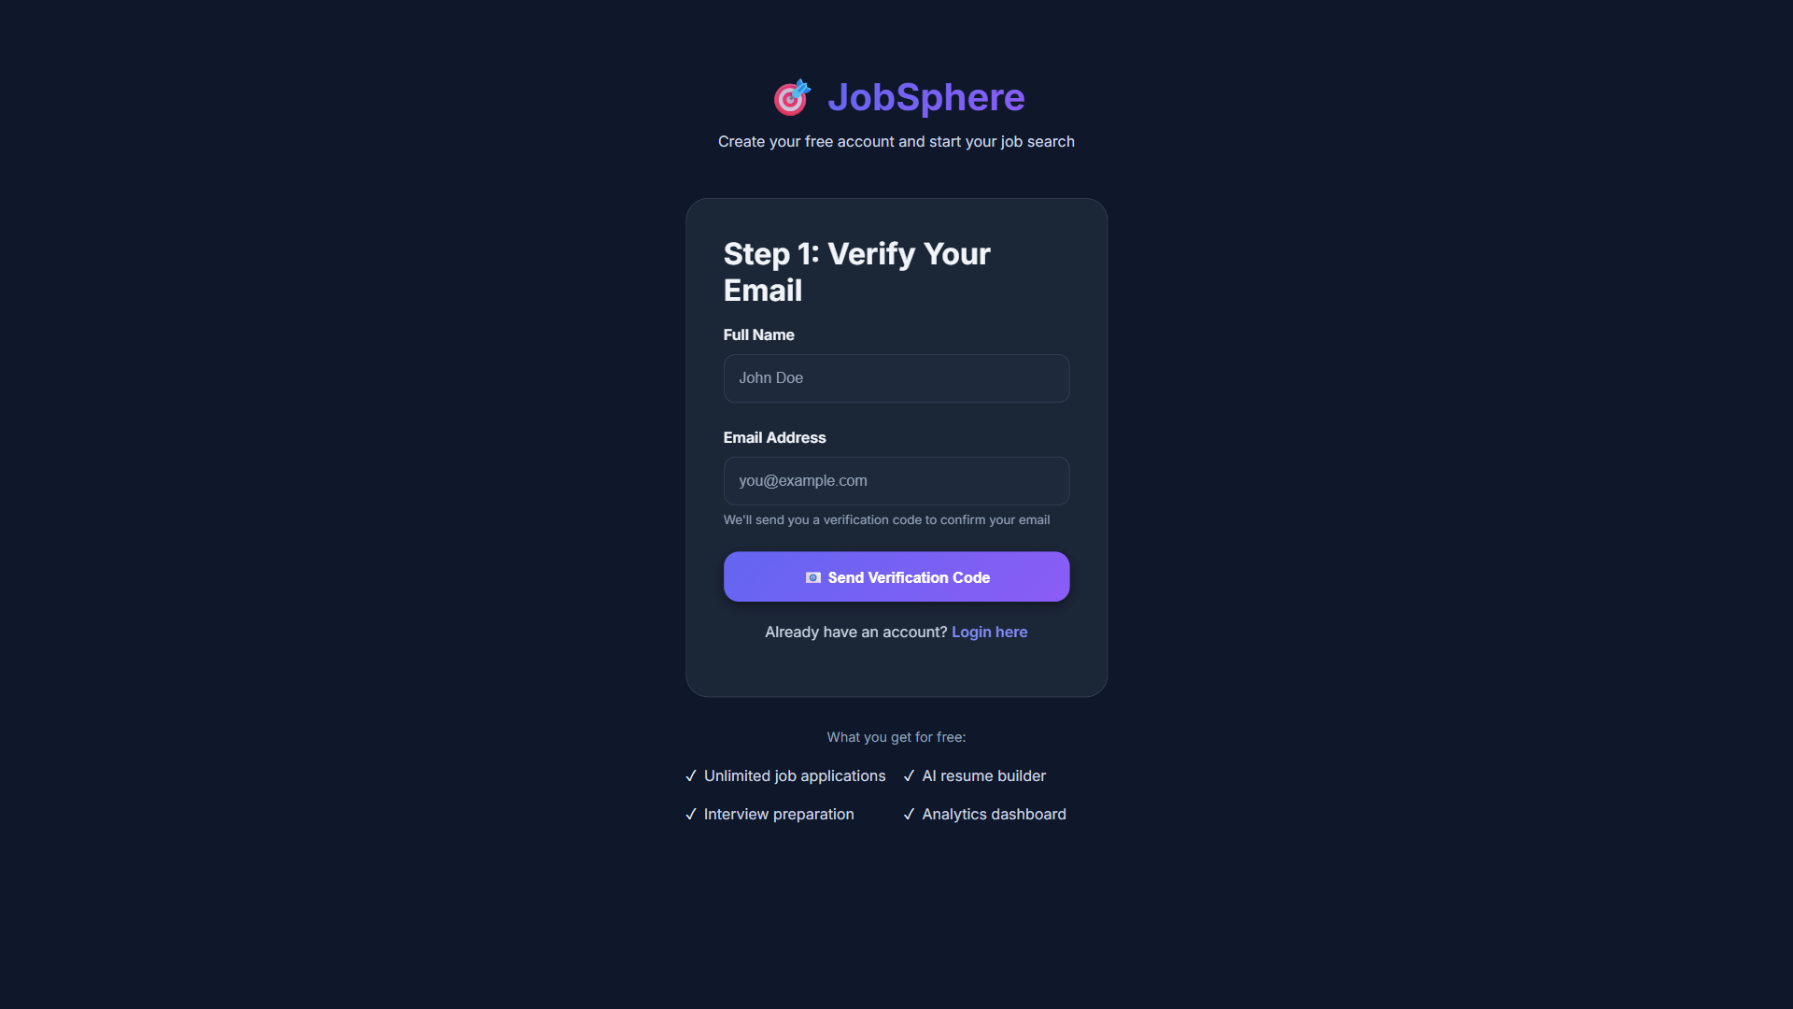
2
User Registration
Streamlined onboarding process for new users

Slide 7
2
User Registration - Process & Features
Efficient and secure user onboarding
Streamlined Process
Secure Password Hashing
Minimal information required to reduce friction - only essential fields for quick registration
Industry-standard bcrypt algorithm for secure password storage and protection
Email Format Validation
Required Fields
Ensures valid contact information with proper email format verification
Full Name, Email Address, and Password with real-time strength validation indicators
Toast Notifications
Real-Time Validation
Instant feedback on registration status - success or error messages with clear guidance
Instant form validation preventing incorrect data entry before submission
Existing Users: Direct link to login page for seamless transition between registration and authentication

Slide 8
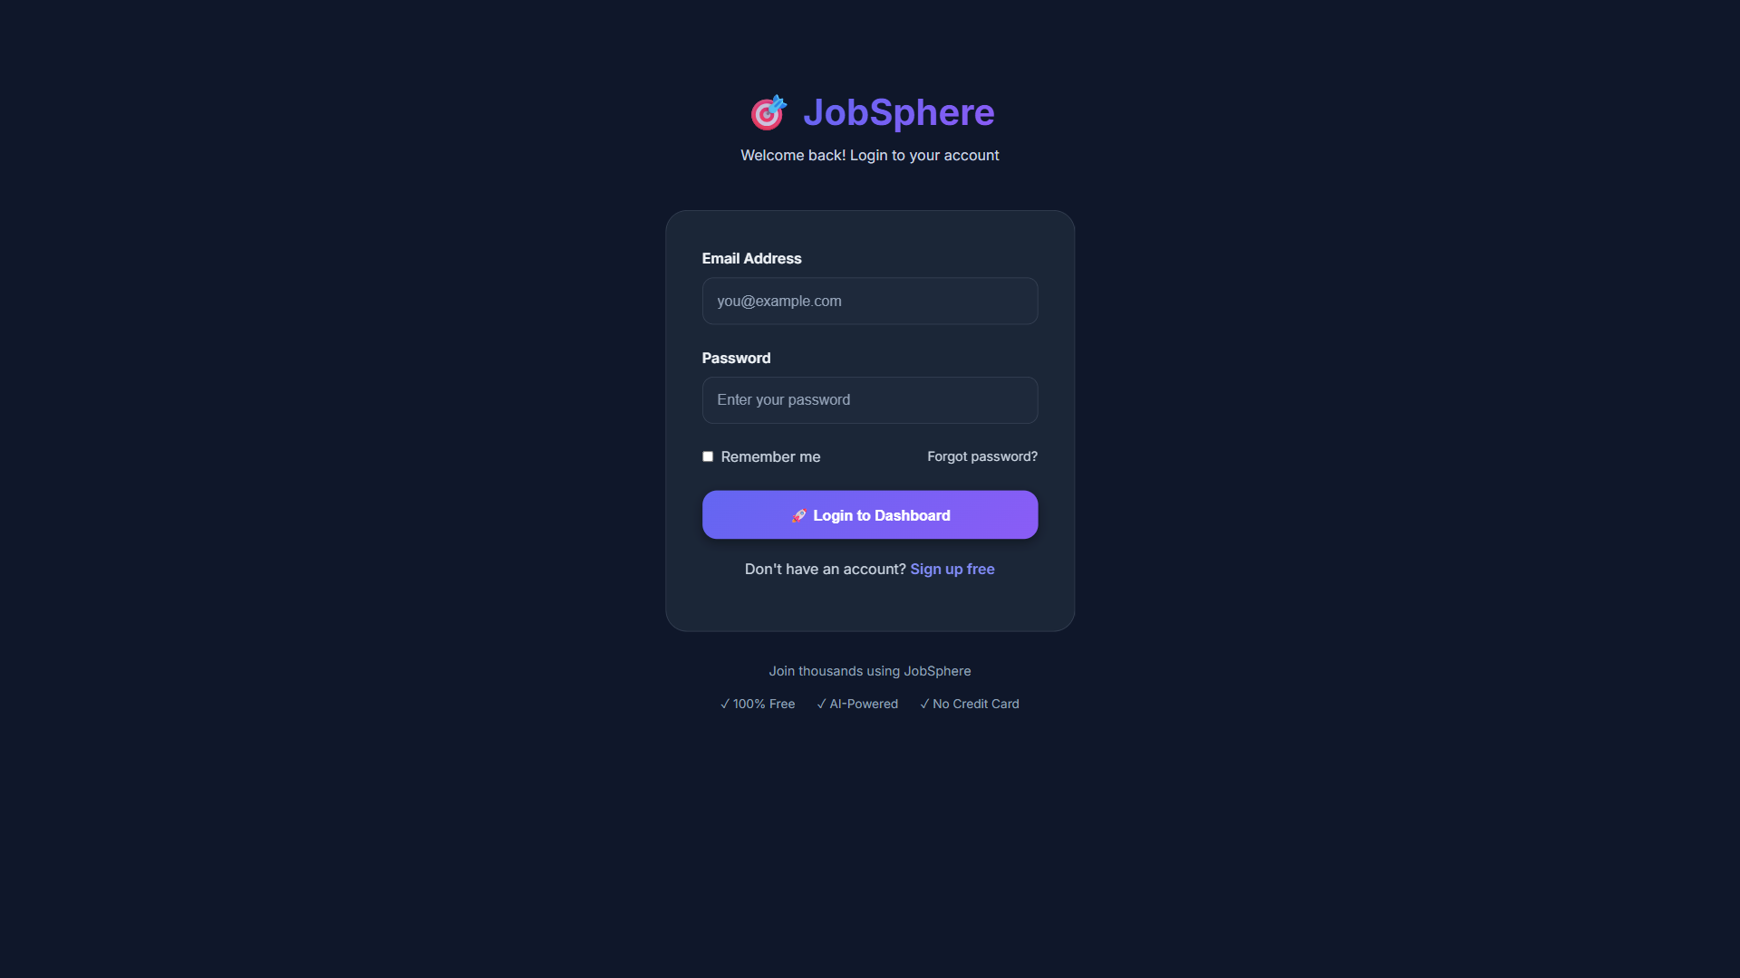
3
Secure Authentication
Robust security for user sessions

Slide 9
3
Secure Authentication - Process & Features
Enterprise-grade security implementation
JWT-Based Authentication
Validation & Error Messaging
JSON Web Tokens ensure secure session management with stateless, scalable authentication
Email and password validation with clear, user-friendly error messages for guidance
Remember Me Functionality
Role-Based Redirect
Convenient access option for returning users with extended session persistence
Automatic redirection based on user role - admin users to admin panel, regular users to dashboard
Forgot Password Link
Account recovery mechanism for password reset (future enhancement planned)
SQLite Verification
Backend verifies credentials against SQLite database with bcrypt password comparison
Token Storage: JWT stored in localStorage for persistent authentication across sessions
Security: All passwords hashed with bcrypt - never stored in plain text

Slide 10
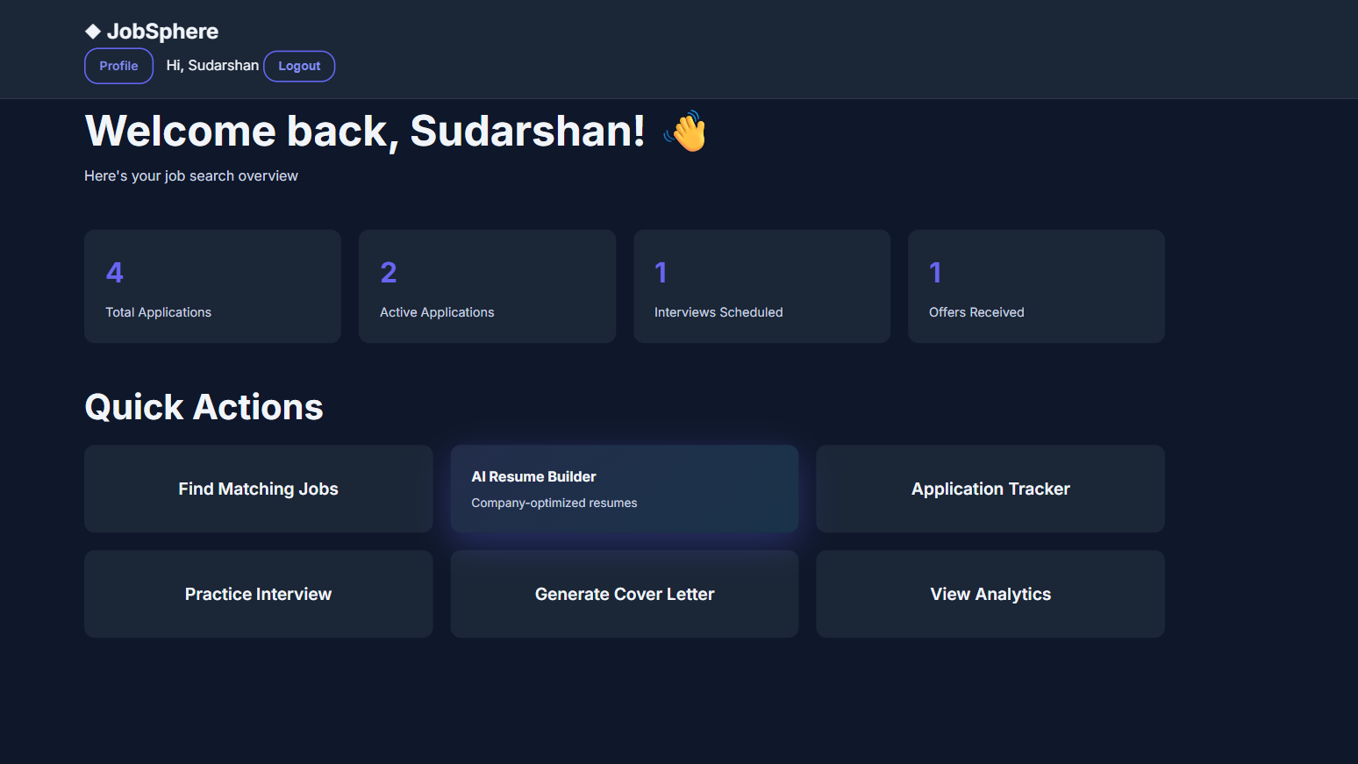
4
Main Dashboard
Central hub for job search management

Slide 11
4
Main Dashboard - Process & Features
Comprehensive overview at a glance
Central Hub
Personalized Welcome
Displays key metrics and statistics at a glance, providing immediate overview of job search progress
Displays user's name for personalized experience and engagement
Four Stat Cards
Total Applications, Active Applications, Interviews Scheduled, and Offers Received - all with visual indicators
Clean Navigation
Intuitive sidebar navigation to all application sections with clear icons and labels
Quick Actions Section
One-click access to major features: Add Application, Search Jobs, Build Resume, Prepare Interview
Responsive Grid Layout
Adapts seamlessly to different screen sizes while maintaining functionality
Real-Time Synchronization
Data automatically syncs with backend API, ensuring users always see the latest information
Status Indicators
Healthy Pipeline
Needs Attention
Urgent Action

Slide 12
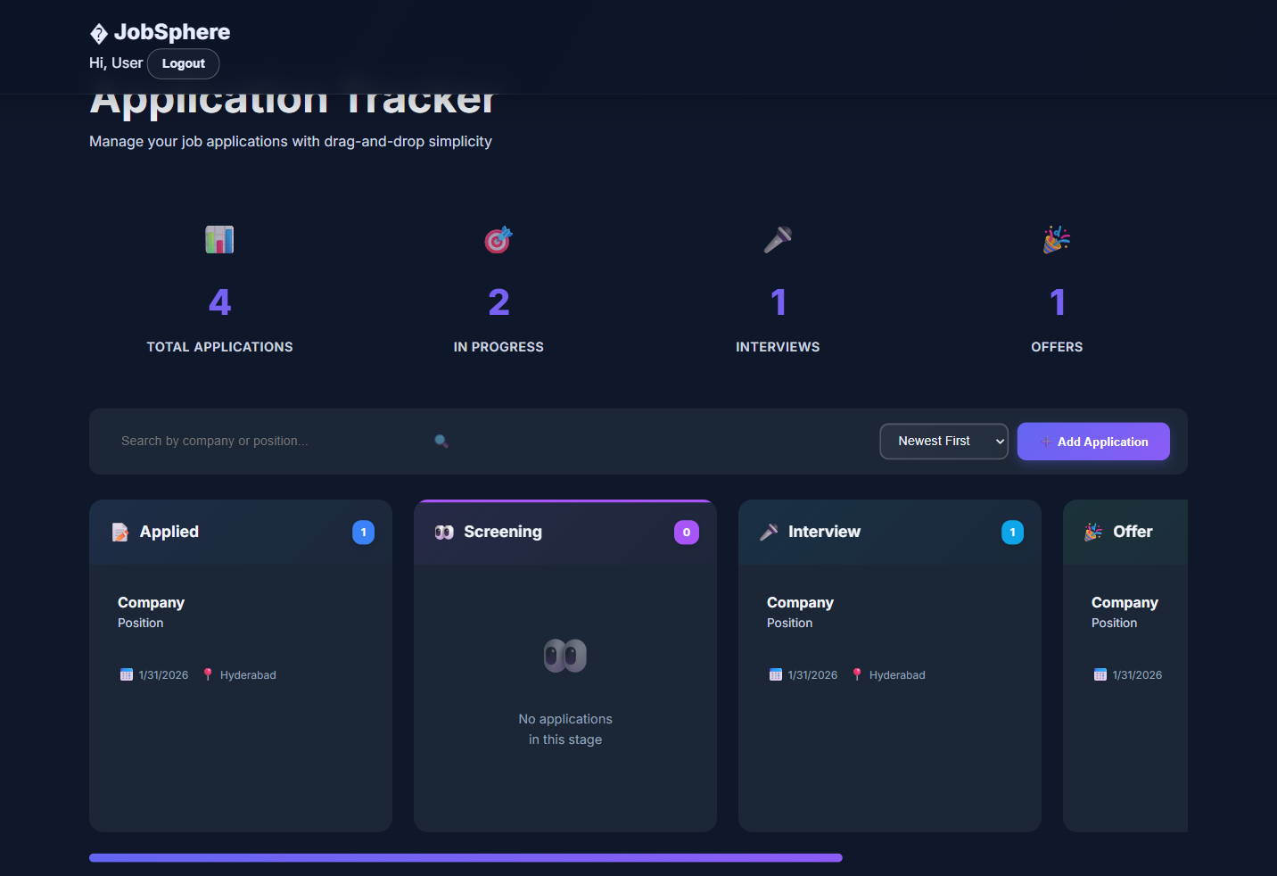
5
Kanban Board Tracker
Visual application tracking methodology

Slide 13
5
Kanban Board Tracker - Process & Features
Intuitive drag-and-drop workflow management
Visual Tracking Methodology
Color-Coded Indicators
Drag-and-drop Kanban board for intuitive application status management and workflow visualization
Visual status indicators for quick reference - different colors for each pipeline stage
Six Status Columns
Filter & Search
Applied → Screening → Interview → Offer → Accepted → Rejected - complete pipeline coverage
Powerful filtering and search capabilities for managing large application volumes efficiently
Drag-and-Drop Functionality
Real-Time Updates
Intuitive status updates by simply dragging cards between columns - no forms needed
Changes reflected across all user sessions instantly - no page refresh required
Mobile-Responsive Design
Card Information Display
Maintains full functionality on all devices with touch-friendly drag-and-drop support
Each card shows: Company name, Position title, Location, and Application Date for quick reference
User Benefit: The Kanban board provides a visual representation of the entire job search pipeline, making it easy to track progress and identify bottlenecks at a glance

Slide 14
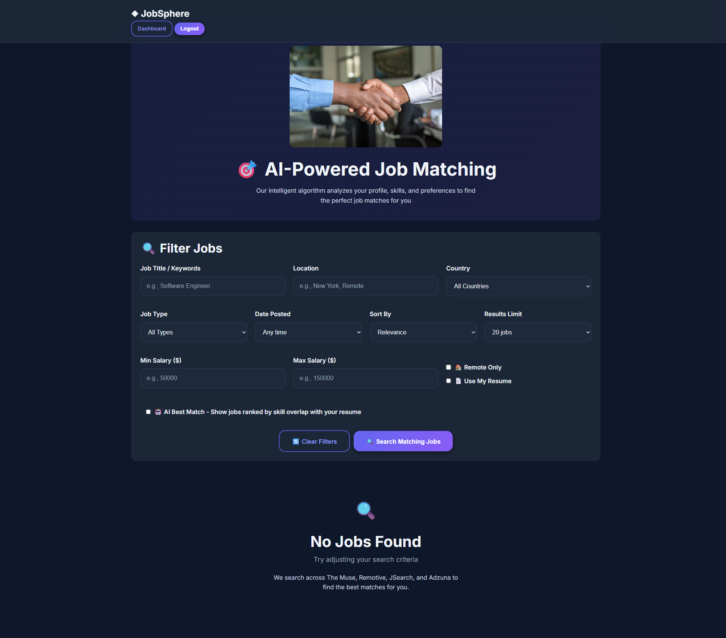
6
Multi-Source Job Search
Unified search from multiple job APIs

Slide 15
6
Multi-Source Job Search - Process & Features
Aggregated job discovery from top platforms
Unified Search Interface
One-Click Apply
Aggregates jobs from multiple APIs into a single, cohesive search experience
Search Filters
Keywords, Location, Job Type, Experience Level - refine results to match preferences
Save for Later
Bookmark interesting opportunities for future review without adding to tracker
Real-Time Results
External Links
Instant search results from JSearch, Adzuna, The Muse, and Remotive APIs
Direct link to original job posting for complete details and application
Job Card Display
API Optimization
Rich cards showing: Title, Company, Location, Salary range, and Job Description preview
Rate limiting and intelligent caching for optimal performance and cost efficiency
Integrated APIs: JSearch API, Adzuna, The Muse, Remotive
Real-Time
Cached
Optimized

Slide 16
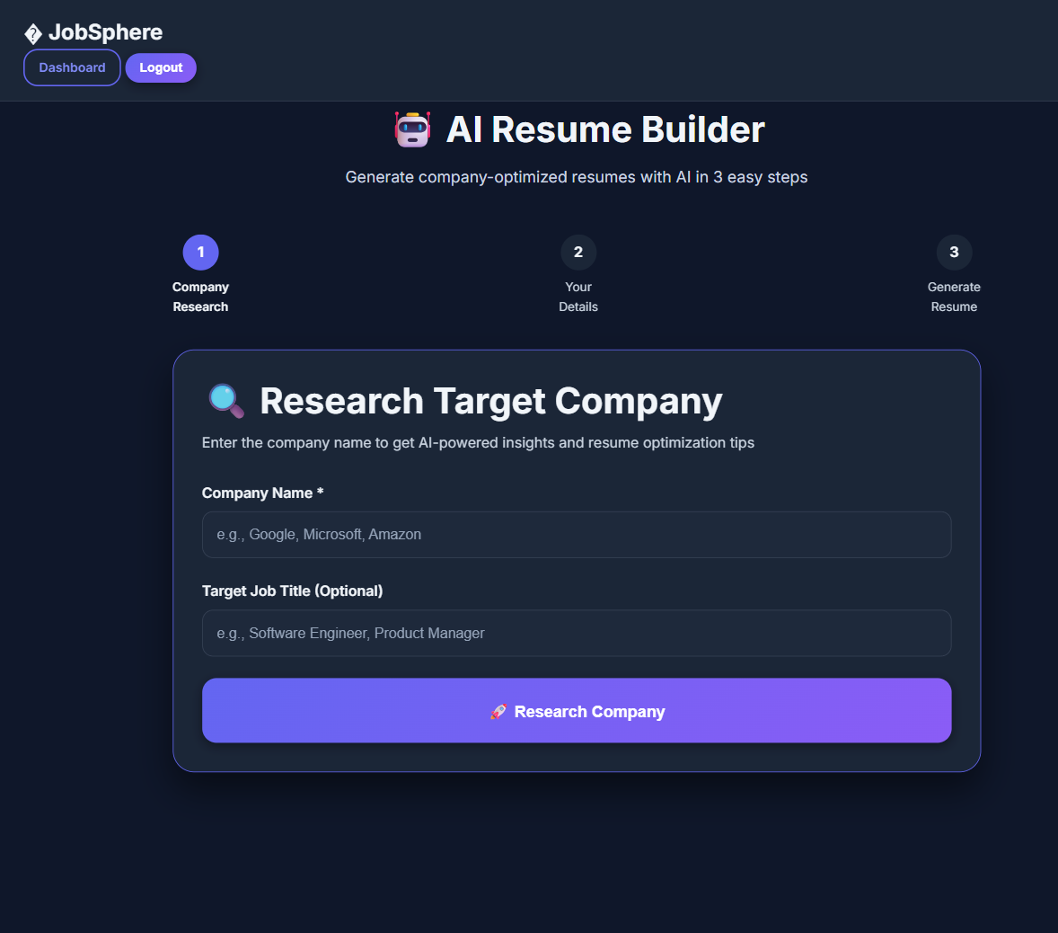
7
AI-Powered Resume Builder
Intelligent resume generation with AI

Slide 17
7
AI-Powered Resume Builder - Process & Features
ATS-optimized resume creation with multiple AI models
Intelligent Generation
Real-Time Preview
Powered by Gemini and OpenAI models for intelligent content generation and optimization
Live preview of generated resume as you input information - instant visual feedback
User Input Fields
Export Options
Personal Info, Education, Experience, Skills, Projects - comprehensive profile capture
PDF and DOCX formats for universal compatibility with application systems
Multiple Versions
ATS Optimization
Save and manage multiple resume versions for different job applications and industries
AI analyzes input and generates ATS-friendly resume content that passes screening systems
AI Suggestions
Multiple Templates
Smart recommendations for improving content based on specific job descriptions
Professional, Modern, and Creative templates to match different career contexts
AI Advantage: The resume builder doesn't just format - it intelligently rewrites and optimizes content to match industry standards and ATS requirements

Slide 18
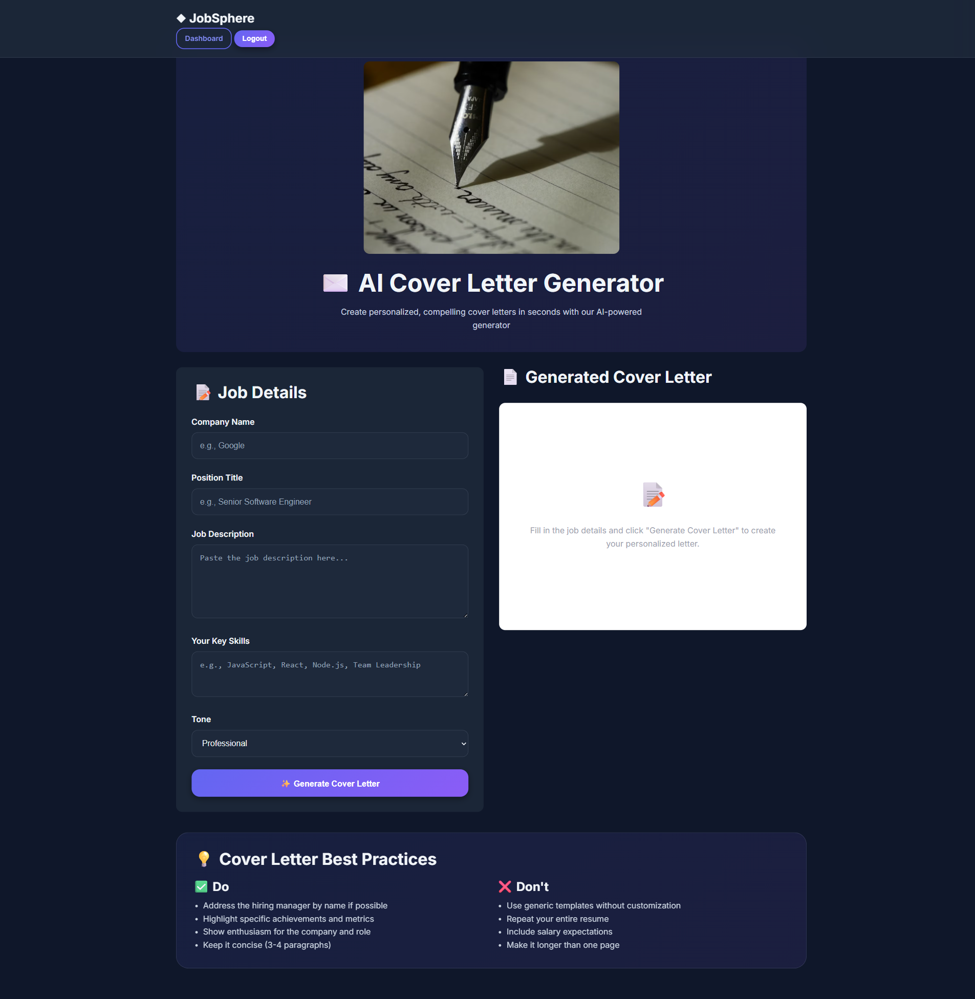
8
Cover Letter Generator
Automated personalized cover letter creation

Slide 19
8
Cover Letter Generator - Process & Features
Tailored cover letters for every application
Automated Creation
Skill Highlighting
Generates tailored cover letters automatically for specific job applications
Intelligently highlights relevant skills that match job requirements and company needs
Input Requirements
Job Title, Company Name, Job Description, and User Skills for personalized content
Customization Options
Ability to add personal touch and customize generated content before finalizing
Personalized Content
Copy to Clipboard
AI generates professional, customized content that speaks to the specific role and company
One-click copy functionality for quick use in job applications and emails
Resume Integration
Automatic Tone & Structure
Seamless integration with resume builder for consistent and cohesive applications
Maintains appropriate professional tone and proper cover letter structure automatically
Time Saver: Generate professional, tailored cover letters in seconds instead of spending hours crafting each one manually

Slide 20
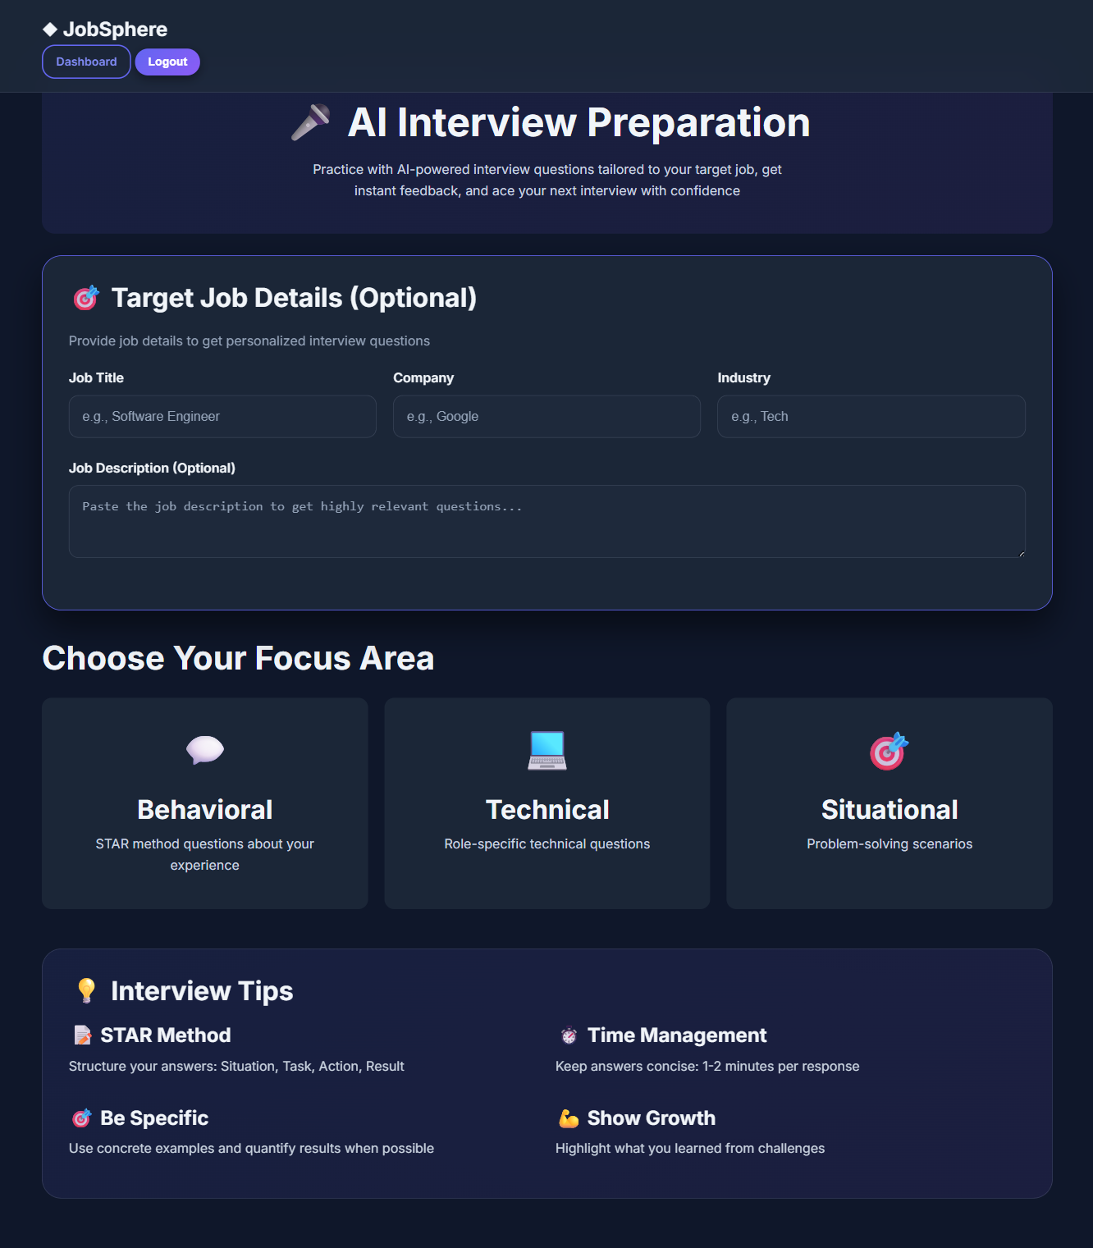
9
Interview Preparation Tool
AI-powered mock interview system

Slide 21
9
Interview Preparation Tool - Process & Features
Practice interviews with multiple AI models
AI-Powered Mock Interviews
Practice Mode
Complete mock interview system powered by advanced AI models for realistic practice
Interactive practice with AI evaluating responses and providing constructive feedback
Multi-Provider Selection
Detailed Feedback
Choose from Gemini, OpenAI, Groq, xAI, and HuggingFace for diverse interview styles
Comprehensive analysis of answer quality with specific improvement areas and suggestions
Customized Questions
Questions Database
Enter job title and company for AI-generated relevant technical and behavioral questions
Common interview questions organized by role type and industry for additional practice
Question Types
Session Saving
Technical questions, behavioral scenarios, and role-specific challenges for comprehensive prep
Save interview sessions for progress tracking and reviewing improvement over time
Interview Ready: Practice with different AI models to experience various interview styles and prepare for any scenario

Slide 22
10
AI Job Matching Engine
Intelligent job recommendations

Slide 23
10
AI Job Matching Engine - Process & Features
Smart recommendations based on profile analysis
Intelligent Recommendations
Advanced Filtering
AI-powered job matching based on comprehensive user profile analysis
Filter recommendations by Industry, Location, Salary range, and Job Type
Profile Analysis
Learning System
Analyzes Skills, Experience, Education, and Career Goals for accurate matching
Learns from user interactions and feedback to continuously improve suggestions
Compatibility Scoring
Job Search Integration
Percentage match score showing how well each job aligns with user profile
Seamless workflow integration - apply to matched jobs directly from recommendations
Detailed Match Breakdown
Explains why each job is a good fit with specific matching criteria highlighted
High-Match Notifications
Alert system for opportunities with exceptional compatibility scores
Smart Matching: The AI engine doesn't just match keywords - it understands career trajectories, skill relevance, and company culture fit

Slide 24
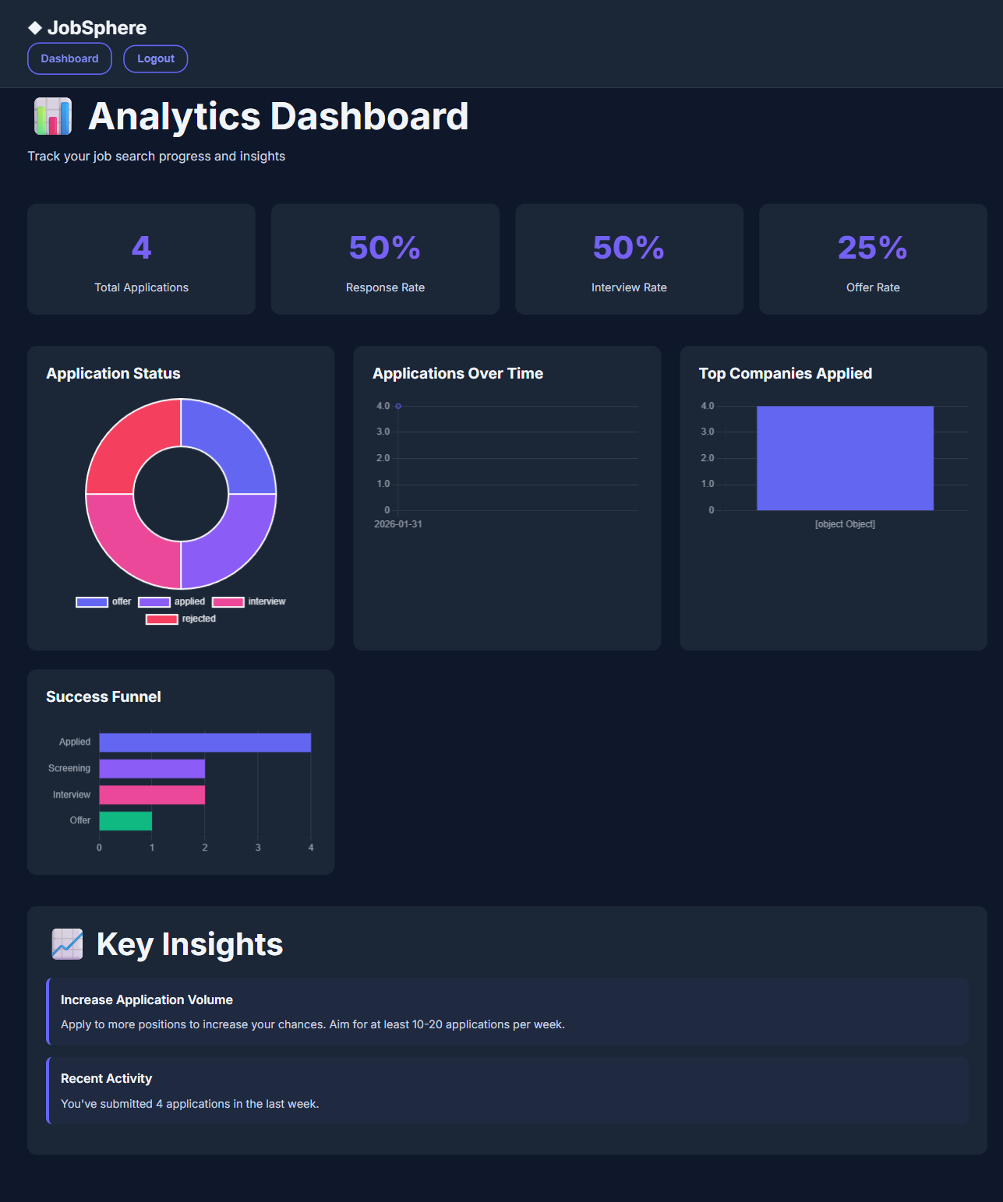
11
Analytics Dashboard
Data-driven insights for job search

Slide 25
11
Analytics Dashboard - Process & Features
Comprehensive visualization of job search metrics
Comprehensive Visualization
Response Time Analysis
Complete overview of job search progress with rich charts and data representations
Track average response times from companies and identify faster-responding employers
Status Distribution Charts
Interview Conversion Tracking
Pie and bar charts showing application distribution across different pipeline stages
Monitor how applications convert to interviews and offers with detailed funnel analysis
Timeline View
Exportable Reports
Track application trends over time with visual timeline showing activity patterns
Generate and download reports for personal records, mentor discussions, or portfolio
Success Rate Calculations
Key metrics and insights on application-to-interview and interview-to-offer conversion rates
Actionable Insights
Data-driven recommendations for improving job search strategy and targeting
Data-Driven Decisions: Transform raw application data into actionable insights that help optimize your job search approach and increase success rates

Slide 26
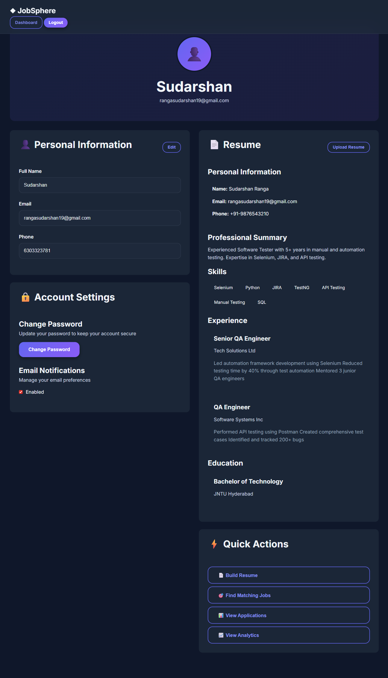
12
User Profile Management
Centralized profile and settings management

Slide 27
12
User Profile Management - Process & Features
Complete control over personal information and preferences
Centralized Settings
Account Security Settings
Single location for managing all profile settings and personal information
Password change functionality and security preferences for account protection
Editable Profile Fields
Notification Preferences
Name, Email, Contact Information, and Professional Summary - all easily updatable
Customize notification settings for job alerts, reminders, and system updates
Data Export Option
Skills Management
Export personal data for privacy compliance, backup, or migration purposes
Add, remove, and organize skills with easy-to-use interface for profile optimization
Profile Completeness
Experience & Education Tracking
Visual indicator encouraging users to complete their profile for better job matching
Complete history management for work experience and educational background
User Control: Complete transparency and control over personal data with easy-to-use management tools

Slide 28
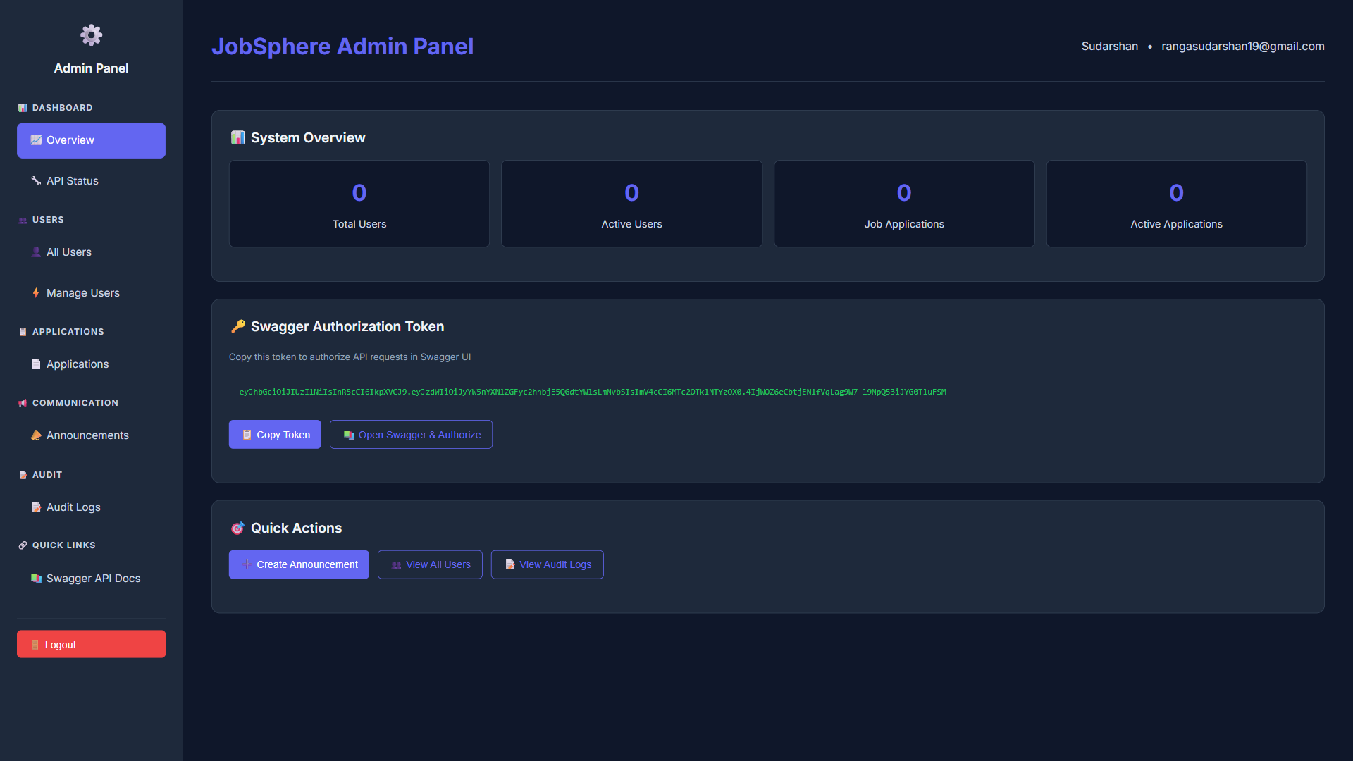
13
Admin Control Panel
System-wide management interface

Slide 29
13
Admin Control Panel - Process & Features
Complete system administration and oversight
System Overview
Announcements
Dashboard displaying Total Users, Total Applications, and Active Sessions in real-time
Broadcast messages to all users for system updates, maintenance, or feature releases
User Management
API Status Monitoring
Suspend, Activate, Delete users, and Grant/Revoke Admin privileges with full control
Health checks for all endpoints with real-time status indicators and alerts
Swagger Authorization
Application Monitoring
Quick access to API documentation with authorized testing capabilities
View all user applications system-wide for oversight and support purposes
Security & Compliance
Audit Logs
Role-based access control ensuring only authorized personnel can access admin functions
Complete activity tracking for security compliance and system monitoring
Admin Power: Complete visibility and control over the entire platform with enterprise-grade management tools

Slide 30
Technical Architecture
Robust, scalable, and modern technology stack
Backend
AI Integration
Deployment
Python FastAPI with async/await for high performance and concurrent request handling
Multi-provider approach ensuring reliability with fallback mechanisms
Lightweight, self-contained, easy to deploy anywhere with minimal dependencies
FastAPI
Python 3.9+
Async
Gemini
OpenAI
Groq
xAI
Docker
Lightweight
Portable
Database
API Design
Key Architecture Benefits
High performance with async operations
SQLite with SQLAlchemy ORM for reliable data persistence and easy migrations
RESTful architecture with comprehensive error handling and validation
99.9% uptime with AI fallback system
Zero-cost deployment possible
SQLite
SQLAlchemy
ORM
REST
OpenAPI
Swagger
Self-contained and portable
Authentication
Frontend
100%
JWT tokens with secure bcrypt password hashing for robust security
Vanilla JavaScript with modular architecture for maintainability
Test Coverage
JWT
bcrypt
OAuth2
JavaScript
HTML5
CSS3

Slide 31
Key Achievements
Project milestones and accomplishments
4+ External APIs Integrated
Robust Authentication & RBAC
Successfully integrated JSearch, Adzuna, The Muse, and Remotive APIs for comprehensive job search
Implemented secure authentication with role-based access control for admin and regular users
5+ AI Models with 99.9% Uptime
100% Test Coverage
Implemented fallback mechanism across Gemini, OpenAI, Groq, xAI, and HuggingFace ensuring reliability
Achieved high test coverage with comprehensive automated testing suite ensuring code quality
Responsive Cross-Device UI
Real-Time Synchronization
Developed fully responsive interface working seamlessly across desktop, tablet, and mobile devices
Implemented real-time data sync across all components for seamless user experience
Comprehensive Admin System
Zero-Cost Deployment
Built complete platform management system with user administration, monitoring, and audit capabilities
Achieved completely free deployment using free-tier API usage and lightweight architecture
Project Success: Delivered a fully functional, production-ready platform with enterprise-grade features
14
5+
4+
Features
AI Models
APIs

Slide 32

Thank You
Questions & Discussion
Student
ID
Billa Ranga Sudarshan
202117B3870
BIRLA INSTITUTE OF TECHNOLOGY & SCIENCE, PILANI
Work-Integrated Learning Programmes Division
AI-Powered
100% Free
Open Source

